Slide 1
Course: Digital Logic Design
Lecture No.04
BSAI/SE – 2nd
Instructor: Dr. Tahir Ejaz

Slide 2
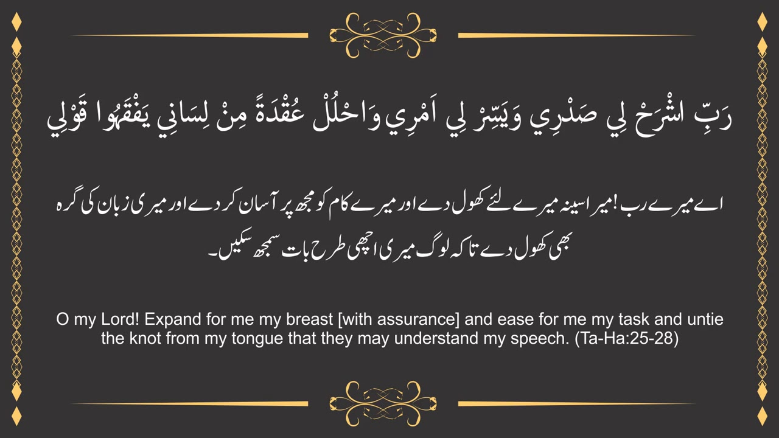

Slide 3
Lecture Contents
Standard Forms of Boolean Expressions
Sum of Product (SOP)
  Minterms
  Examples
Product of Sum (POS)
  Maxterm
  Examples

Slide 4
Standard Forms of Boolean Expressions

Slide 5
Standard forms of Boolean Expressions
All Boolean expressions, regardless of their form, can be converted into either of two standard forms
Sum-of-Products (SOP) form
  Also called Minterms
Product of Sums (POS) form
  Also called Maxterms
Standardization makes the evaluation, simplification, and implementation of Boolean expressions much more systematic and easier.

Slide 6
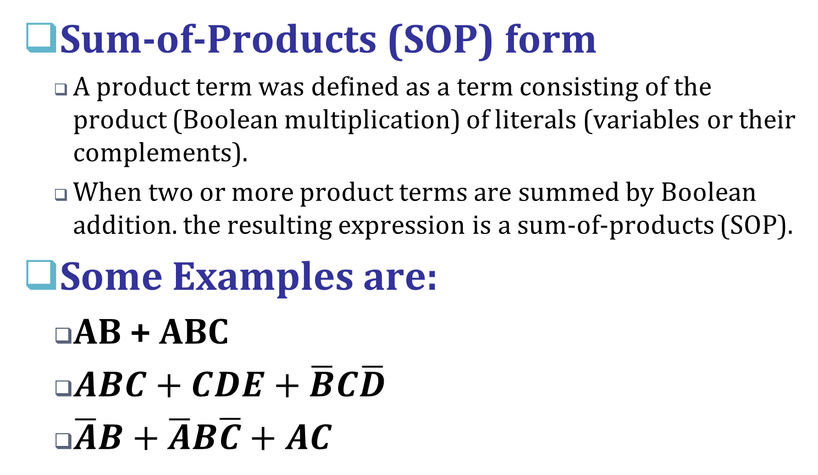
Standard forms of Boolean Expressions

Slide 7
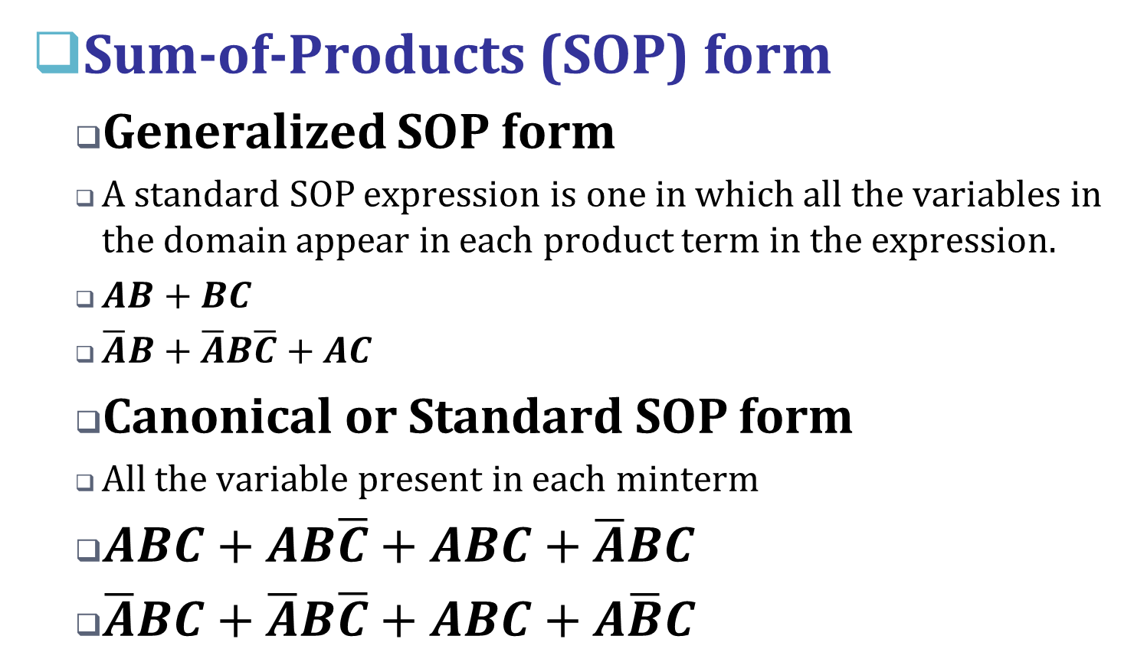
Standard forms of Boolean Expressions

Slide 8
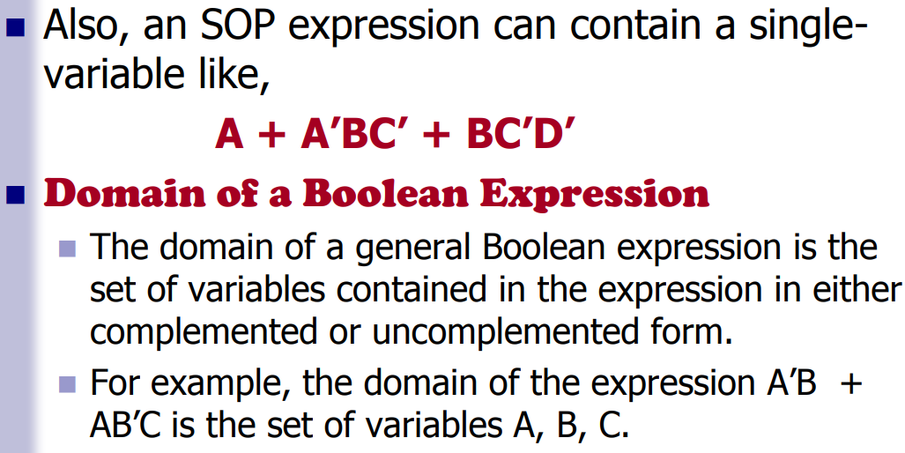
Sum of Products (SOP)

Slide 9
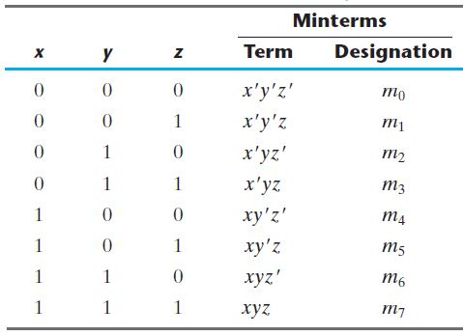
Sum of Products (SOP)
Truth Table of (SOP) form

Slide 10
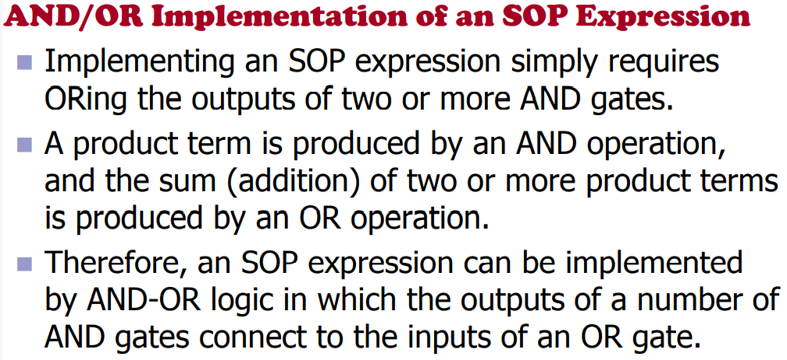
Sum of Products (SOP)

Slide 11
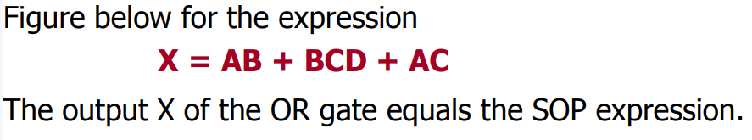
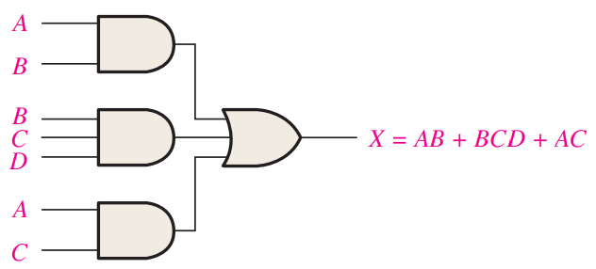
Sum of Products (SOP)

Slide 12
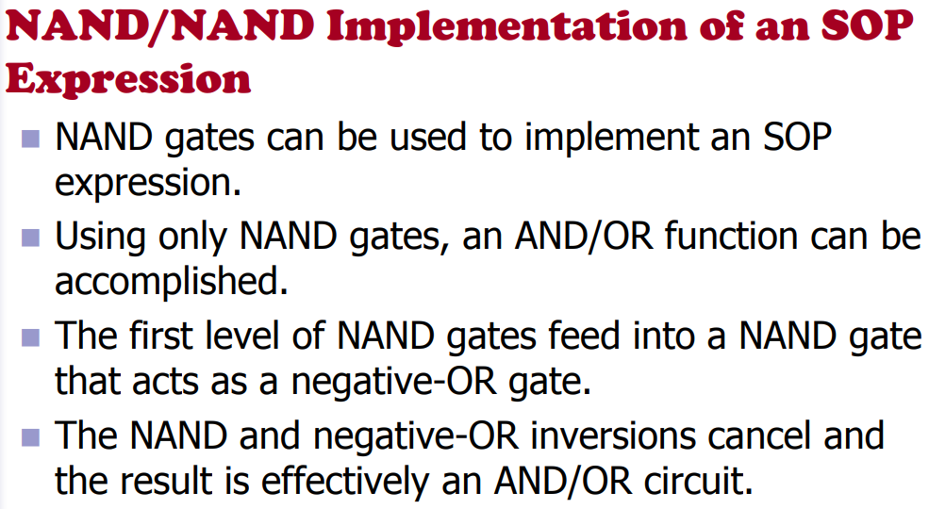
Sum of Products (SOP)

Slide 13
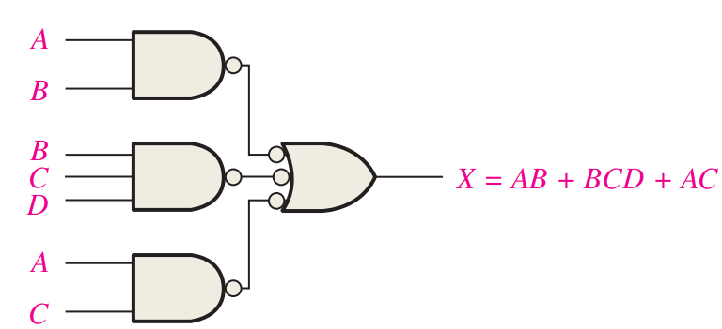
Sum of Products (SOP)

Slide 14
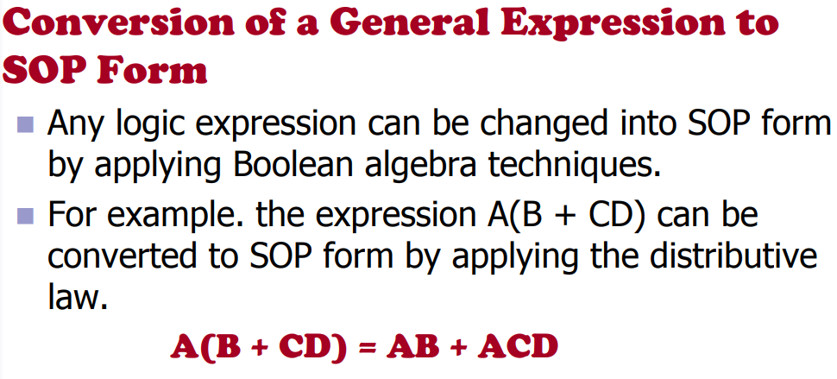
Sum of Products (SOP)

Slide 15
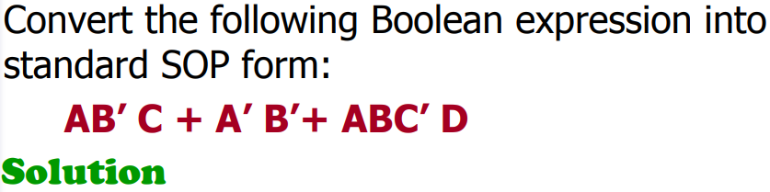
Sum of Products (SOP)

Slide 16
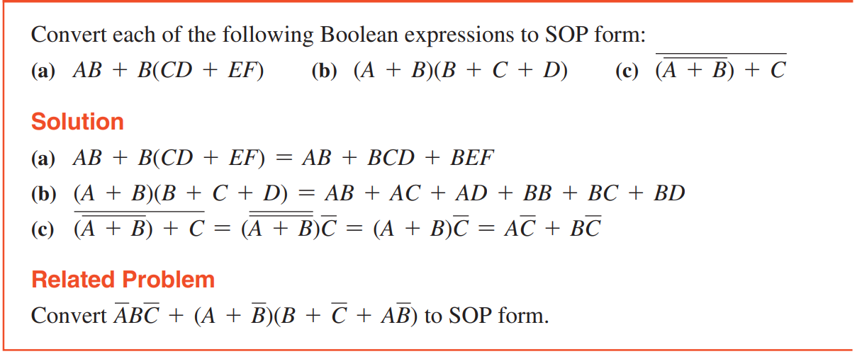
Sum of Products (SOP) Examples

Slide 17
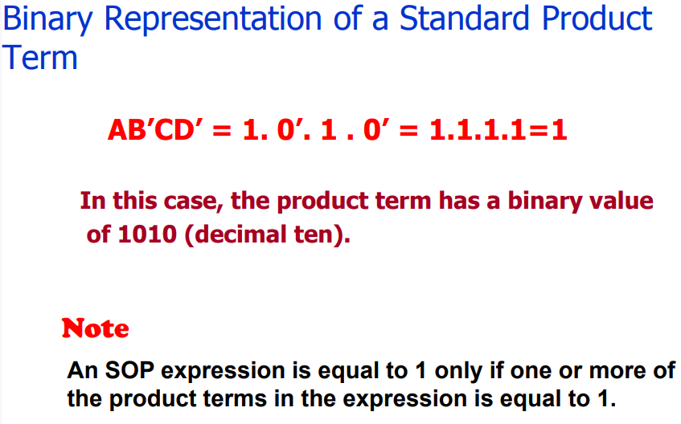
Sum of Products (SOP)

Slide 18
Standard forms of Boolean Expressions
Product-of-Sums (POS) form
  When two or more sum terms are multiplied, the resulting expression is a product-of-sums (POS).
Some Examples are:
  (A’ + B)(A + B’ + C)
  (A + B’ + C)( C + D’ + E’)(B + C’ + D)
  (A’ + B)(A’ + B’ + C’)(A + C’)

Slide 19
Standard forms of Boolean Expressions
Product-of-Sums (POS) form
  POS expressions in which some of the sum terms do not contain all of the variables in the domain of the expression. For example. the expression called Generalized POS
  (A + B’ + C) (A + B + D’) (A + B’ + C’ + D)
Canonical POS form:
  A standard POS expression is one in which all the variables in the domain appear in each sum term in the expression. For example,
  (A’ + B’ + C’ + D’)(A + B’ + C + D)(A + B + C’ + D)

Slide 20
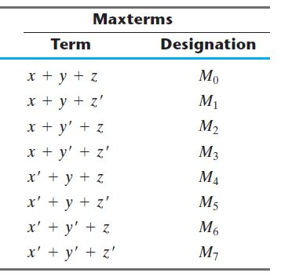
Standard forms of Boolean Expressions
Truth table of (POS) form

Slide 21
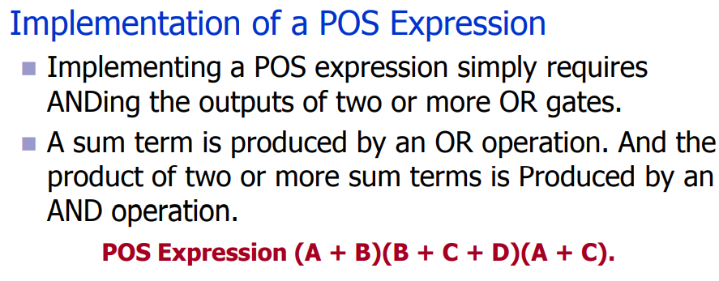
Product of Sum (POS)

Slide 22
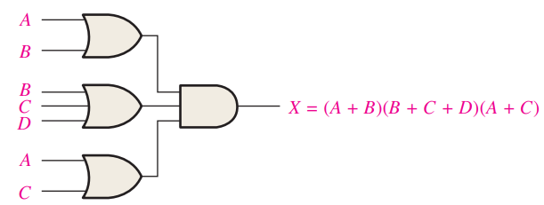
Product of Sum (POS)

Slide 23
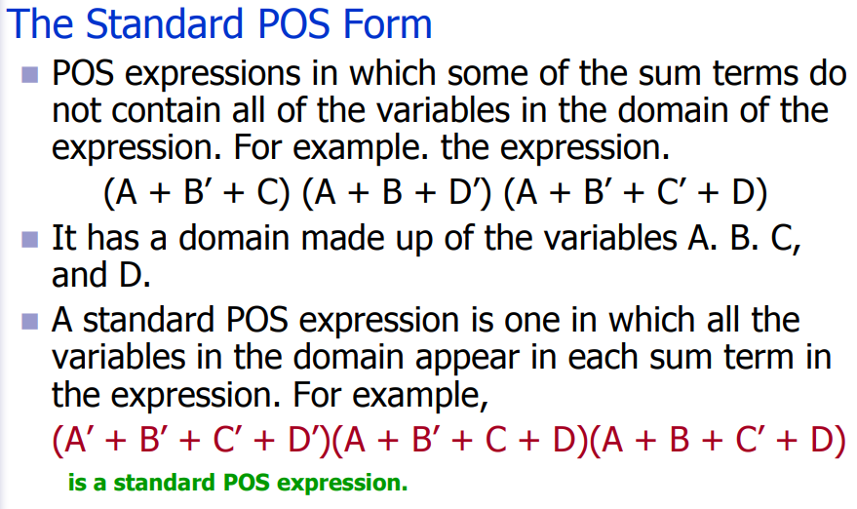
Product of Sum (POS) Truth Table

Slide 24
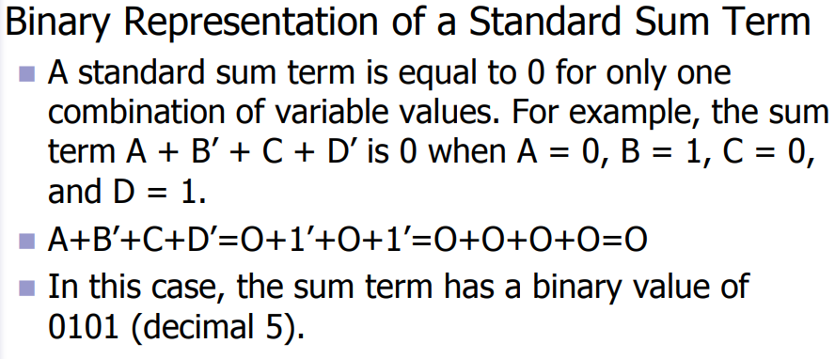
Product of Sum (POS)

Slide 25
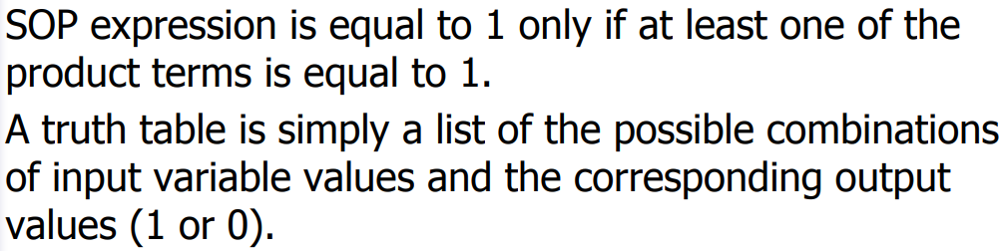
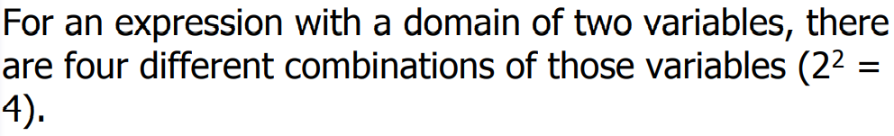
SOP to Truth Table

Slide 26
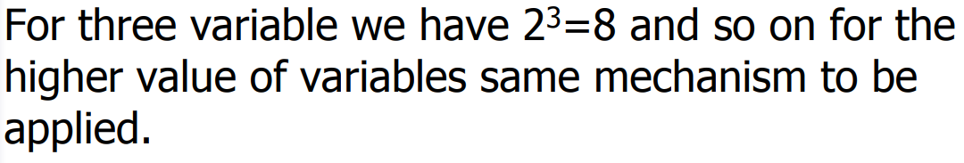

SOP to Truth Table

Slide 27
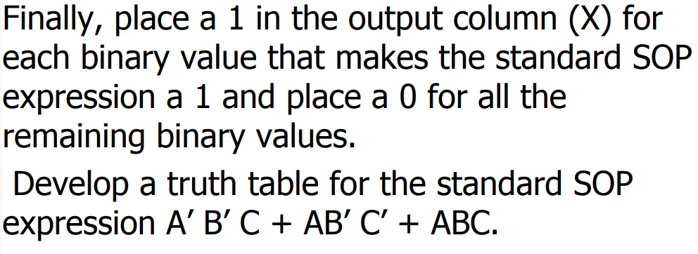
SOP to Truth Table

Slide 28
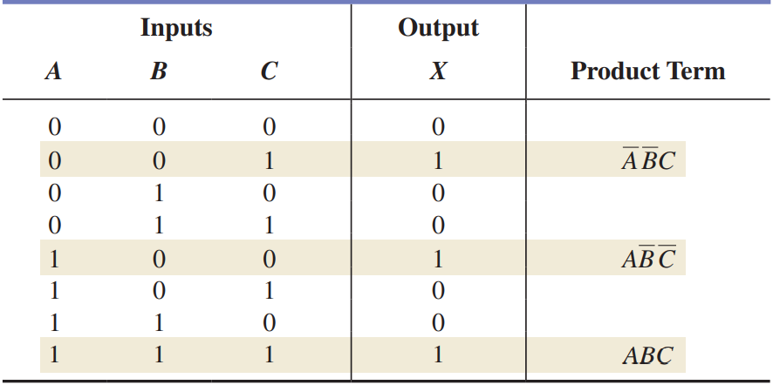
SOP to Truth Table (Example)

Slide 29
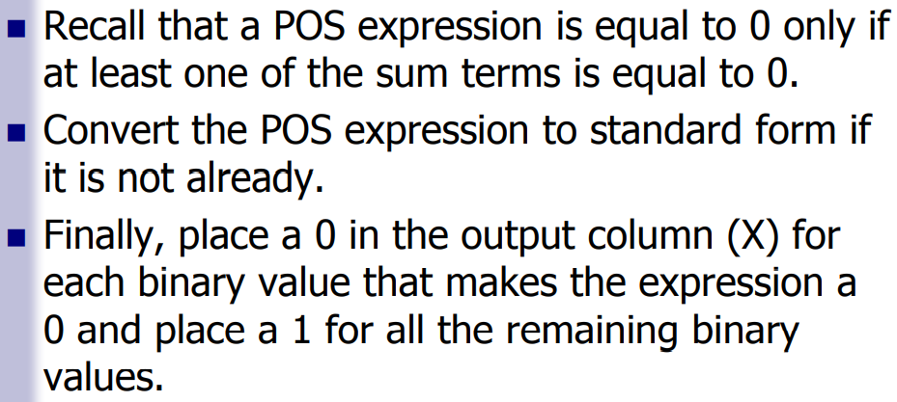
POS to Truth Table

Slide 30
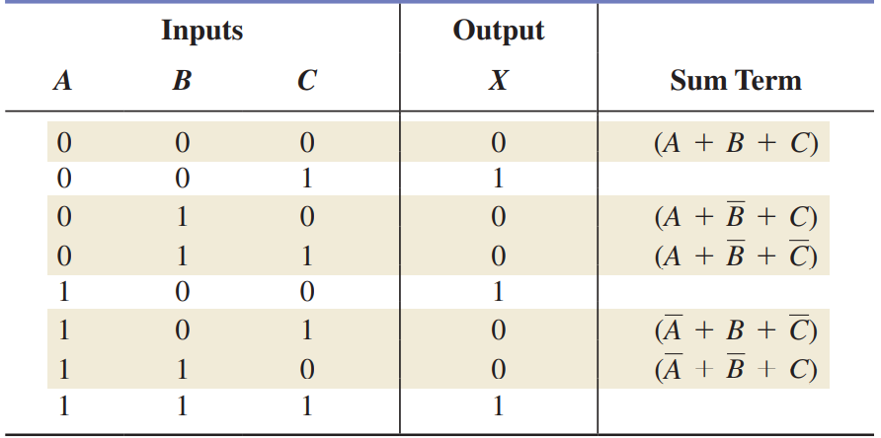
POS to Truth Table (Example)

Slide 31
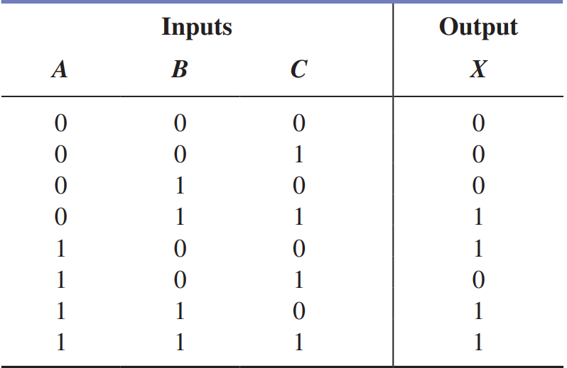
Truth Table to SOP & POS
From the truth table given below, determine the standard SOP expression and the equivalent standard POS expression.

Slide 32
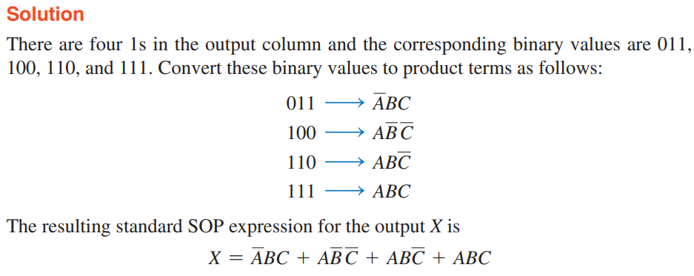
Truth Table to SOP & POS

Slide 33
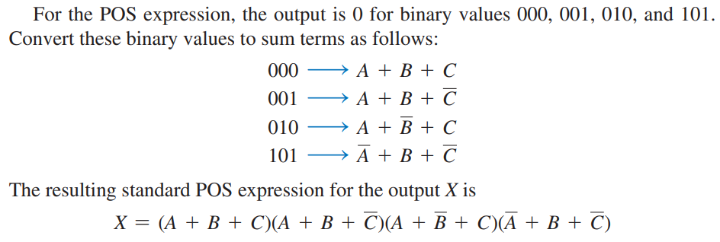
Truth Table to SOP & POS

Slide 34
Standard forms of Boolean Expressions
Product-of-Sums (POS) form
  Convert the following Boolean expression into standard POS form:
  (A + B ́ + C)(B’ + C + D’)(A + B’ + C’ + D)
  Solution:
  The domain of this POS expression is A, B, C, D.
  The first term, A + B’ + C, is missing variable D or D’, so add DD’ and apply rule 12 as follows:
  A + B’ + C = A + B’ + C + DD’
  = (A + B’ + C + D)(A + B’ + C + D’)

Slide 35
Standard forms of Boolean Expressions
  Solution:
  A + B’ + C = A + B’ + C + DD’
  = (A + B’ + C + D)(A + B’ + C + D’)
  The third term, A + B’ + C’ + D, is already in standard form
  The standard POS form of the original expression is as follows:
(A + B’ + C)(B’ + C + D’)(A + B’ + C’ + D)=
(A + B’ + C + D)(A + B’ + C + D’) (A + B’ + C + D’)(A’ + B’ + C + D’)(A + B’ + C’ + D)

Slide 36
Standard forms of Boolean Expressions
Product-of-Sums (POS) form
  Convert the following Boolean expression into standard POS form:
  (A + B ́)(B + C)
  Solution:

Slide 37
Sum-of-Products (SOP) form
  Examples:
  Express the following Boolean function into a Standard SOP form:
  F = A + B’C
  Solution:
  F = A(B + B’) + B’C(A + A’)
  F = AB + AB’ + AB’C + A’B’C
  F= AB(C + C’) + AB’(C + C’) + AB’C + A’B’C
  F = ABC + ABC’ + AB’C + AB’C’ + AB’C + A’B’C

Slide 38
Sum-of-Products (SOP) form
  Examples:
  Express the following Boolean function into a Standard SOP form:
  F = A + B’C
  Solution:
  F = ABC + ABC’ + AB’C + AB’C’ + A’B’C
Minterms

Slide 39
Sum-of-Products (SOP) form
  Examples:

Slide 40
Sum-of-Products (SOP) form
  Examples:
  Express the following Boolean function into a Standard SOP form:
  F = A + B’C
  Solution:
  F = ABC + ABC’ + AB’C + AB’C’ + A’B’C
  F = m₇ + m₆ + m₅ + m₄ + m₁
  And minterms = F(A,B,C) = Σ(1,4,5,6,7)
  Maxterm F(A,B,C) = Π(0,2,3)

Slide 41
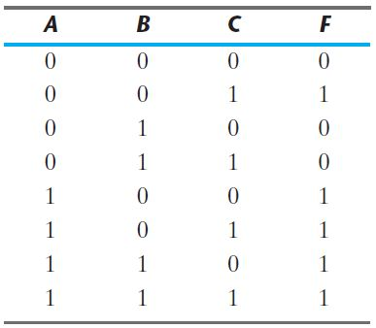
Sum-of-Products (SOP) form
  Examples:
  Express the following Boolean function into a Standard SOP form:
  F = A + B’C
  (Truth Table)

Slide 42
Sum-of-Products (SOP) form
  Examples:
  Express the following Boolean function into a Standard POS form:
  F = (A + BC)(B + AC)
  Solution:
  F = (A + B)(A + C) (A+ B)(B + C)
  F = (A + B)(A + C)(B + C)
  F= (A + B + CC’)(A + C + BB’) (AA’ + B + C)
  F = (A + B + C)(A + B + C’)(A + B + C)(A + B’ + C)(A + B + C)(A’ + B + C)

Slide 43
Sum-of-Products (SOP) form
  Examples:
  Express the following Boolean function into a Standard POS form:
  F = (A + BC)(B + AC)
  Solution:
  F = (A + B + C)(A + B + C’)(A + B’ + C)(A’ + B + C)
Maxterms

Slide 44
Sum-of-Products (SOP) form

Slide 45
Sum-of-Products (SOP) form
  Examples:
  Express the following Boolean function into a Standard POS form:
  F = (A + BC)(B + AC)
  Solution:
  F = (A + B + C)(A + B + C’)(A + B’ + C)(A’ + B + C)
  F = M₀ M₁ M₂ M₄
  Maxterm F(A,B,C) = Π(0,1,2,4)
  And minterms = F(A,B,C) = Σ(3,5,6,7)

Slide 46
Sum-of-Products (SOP) form
  Examples: From the truth table, determine the standard SOP expression and the equivalent standard POS expression.

Slide 47
Sum-of-Products (SOP) form
  Solution:
There are four 1s in the output column and the corresponding binary values are 011, 100, 110 and 111.
Convert these binary values to product terms as follows:

Slide 48
Sum-of-Products (SOP) form
  Solution:
The resulting standard SOP expression for the output X is,
X = A’BC + AB’ C’ + ABC’ + ABC
For the POS expression, the output is 0 for binary values 000. 001, 010, and 101. Convert these binary values to sum terms as follows:

Slide 49
Sum-of-Products (SOP) form
  Solution:
The resulting standard POS expression for the output X is,
X=(A+B+C) (A+B+C’) (A+B’+C) (A’+B+C’)

Slide 50
Lecture Summary
Standard forms of Boolean Expressions
  Sum-of-products (SOP) form
    Generalized SOP form
    Canonical or Standard SOP form
    Examples
  Product of Sum (POS) form
    Generalized SOP form
    Canonical or Standard SOP form
    Examples
  Truth table --- SOP & POS form

Slide 51
Lecture Summary
Boolean Algebra and Expressions
  Examples
  Problems
Laws & Rules of Boolean Algebra
  Examples
  Problems
DeMorgan’s Theorems
  Proof, Examples & Problems

Slide 52
Useful Videos
https://www.youtube.com/watch?v=U0WjEkylfPc
https://www.youtube.com/watch?v=7o8oo5m0vqQ
https://www.youtube.com/watch?v=QkF4iMK2XkA
https://www.youtube.com/watch?v=1FUoHJW_am4

Slide 53
Thank You !

